Slide 1
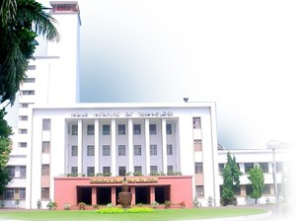

Design Verification – Overview
Testing & Verification
Dept. of Computer Science & Engg, IIT Kharagpur
Pallab Dasgupta
Professor, Dept. of Computer Science & Engg.,
Professor-in-charge, AVLSI Design Lab,
Indian Institute of Technology Kharagpur

Slide 2
Design Flows: Digital versus Analog
Design Concept
Design Entry
Schematic Entry
Verilog / VHDL
SDL
Spice Simulation
Behavioral Simulation
Custom Layout
Synthesis
DRC
Place & Route
Extract netlist
Post-Layout Simulation
Post-Layout Simulation
Full Chip Assembly
Full Chip DRC
Full Chip Simulation
DRC: Design Rule Checking
SDL: Schematic Driven Layout
Tape Out

Slide 3
Design Cycle: Intent Creation
Architectural
Specification
English
Is the intent correct?
Executable
Specs (CSpec)
C, SystemC, Esterel
Component
Specs Document
English
Design intent creation

Slide 4
Design Cycle: Implementation
Component
Specs Document
English documents
Implementation
validation
(Spec
vs RTL)
RTL implementation
Design integration
Verilog, VHDL
Synthesis
Equivalence
checking
Gate Level Netlist
Technology mapping
Transistor Level
(Schematic)
Layout
Mask

Slide 5
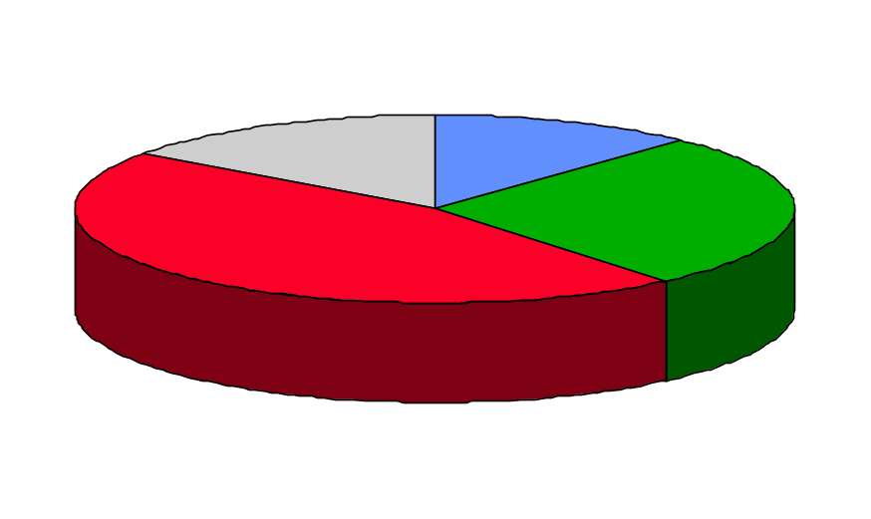
Verification Dominates Design
Synthesis
Timing analysis
Equivalence checking
DFT
Emulation
15%
Structural
12%
Design
27%
Simulation
46%
High-level design
RTL coding
Block-level simulation
Behavioral modeling
Architecture level simulation
System level simulation
Source: 0-In Design Automation

Slide 6
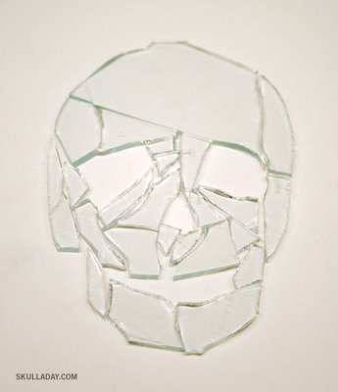
Pieces of the verification puzzle
Architecture
validation
Unit
validation
Timing
validation
Microcode
validation
Cluster
validation
Debugging
validation
Full-chip
validation
Protocol
validation
Power
validation
Picture source:skulladay.com

Slide 7
Design and Verification
specifications
does it meet the specs?
property
checking
micro-architecture
does it implement the μ-arch?
design
RTL
verification
are they equivalent?
gate netlist
equivalence
checking
are they equivalent?
layout

Slide 8
Functional Verification Challenge
Is the implementation correct?
  How do we define correct?
    Classical: Simulation result matches with golden output
    Formal: Equivalence with respect to a golden model
    Property verification: Correctness properties (assertions) expressed in a formal language
      Formal: Model checking
      Semi-formal: Assertion-based verification
  Trade-off between computational complexity and exhaustiveness

Slide 9
Simulation
Design
Test Plan
Test Bench
Stimulus Generation
Simulation
Coverage Metrics
Debug
Bug Tracking
Advances:
Test bench languages are richer (such as SystemVerilog)
Coverage monitors and assertions
Layered test benches and Transaction Level Modelling

Slide 10
Advent of Formal Methods in EDA
Goal: Exhaustive verification of the design intent within feasible time limits
Philosophy: Extraction of formal models of the design intent and the implementation
and comparing them using mathematical / logical methods
Formal Properties
Design Intent
Temporal Logics
(Turing Award: Amir Pnueli)
Adopted by Accelera / IEEE
Integrated into SystemVerilog
Tools:
Academia: NuSMV, VIS
Industry: Magellan (Synopsys)
IFV (Cadence)
2008: Clarke & Emerson get
Turing Award
Model
Checking
always @( posedge clk )
begin
if (!rst) begin a1 <= a2;
a2 <= ~a1; end;
end
Register Transfer
Level
Logical
Equivalence
Checking
Gate Level
Transistor Level

Slide 11
Toy example: Priority Arbiter
Either g1 or g2 is always
false (mutual exclusion)
G[¬g1 ∨ ¬g2]
r1
g1
g2
r2
Whenever r1 is asserted, g1 is given in the next cycle
G[ r1 ⇒ Xg1 ]
When r2 is the sole request, g2 comes in the next cycle
G[ (¬r1 ∧ r2) ⇒ Xg2 ]
When none are requesting, the arbiter parks the grant on g2
G[ (¬r1 ∧ ¬r2) ⇒ Xg2 ]
Violation!!

Slide 12
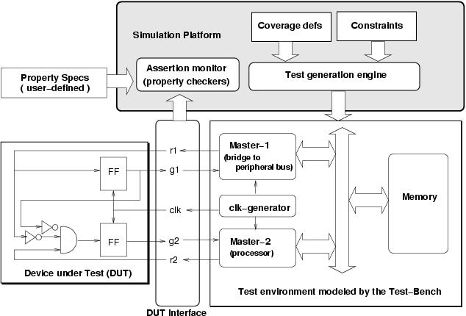
Dynamic Property Verification (DPV)
[Source: A Roadmap for Formal Property Verification, Springer, 2006]

Slide 13
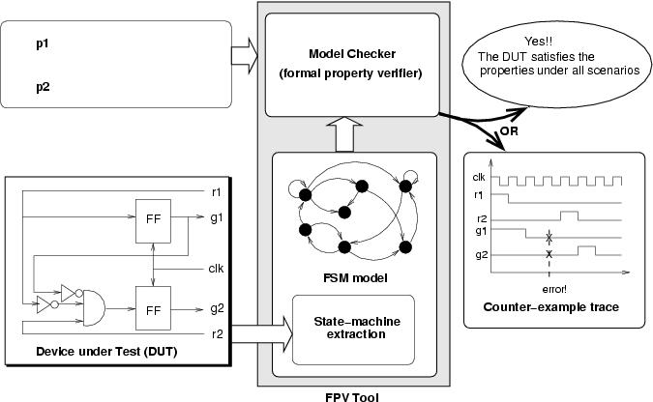
Formal Property Verification (FPV)
always !g1 || !g2
always r2 && !r1 → next g2
Formal Properties
Temporal Logics (Timed / Untimed, Linear Time / Branching Time): LTL, CTL
Early Languages: Forspec (Intel), Sugar (IBM), Open Vera Assertions (Synopsys)
Current IEEE Standards: SystemVerilog Assertions (SVA),
Property Specification Language (PSL)

Slide 14



Assertion Based Verification Flow
Model +
Properties
Decompose, Abstract,
Over Constrain
Model Checker
Refine the model or assertions
Modify assumptions
Stuck ? None of the
Abstractions working
YES
Indeterminate
Results
YES
NO
Spurious
cex
Bug Hunting
(Directed Simulation assisted MC)
PASS
Closure ?
NO
NO
YES
[Source: Raj Mitra, TI]

Slide 15
Course Agenda: Verification Track
Design Entry: Brief overview of Verilog
Simulators: How they work
Test Scenarios and Coverage
Static Checks
Symbolic Representation of Logic and State Spaces: BDDs, SAT
Equivalence Checking
Assertions
Formal Property Verification: Model Checking
Formal Verification Coverage

Slide 16
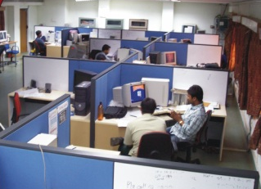









Verification Group Profile
The verification research group focuses on providing industrially relevant methods for the verification of various designs – ranging from digital and mixed-signal chip designs to complex software and embedded systems such as automotive control systems. Areas of strength include:
  Design Intent Verification
  Formal Verification Coverage
  Mixed-signal Design Verification
  Coverage-driven Semi-Formal Verif.
  Verification of Automotive Systems
  Verification of Web Interfaces
Home: http://www.facweb.iitkgp.ernet.in/~pallab/forverif.html
Research Partners / Sponsors:
DST Govt. of India

Slide 17
The Family
PhD Students:
J.K. Deka (Completed)
Prasenjit Basu (Submitted)
Sayantan Das (Completed)
Ansuman Banerjee (Submitted)
Suchismita Roy (Submitted)
Bhaskar Pal (Submitted)
Arijit Mondal (Ongoing)
P.V. Rajkumar (Ongoing)
Manoj Dixit (Ongoing)
Srobona Mitra (Ongoing)
Priyankar Ghosh (Ongoing)
Chandan Karfa (Ongoing)
Subrat Panda (Ongoing)
Dipankar Das (Ongoing)
MS Students:
Ansuman Banerjee (Completed)
Bhaskar Pal (Completed)
Pritam Ray (Completed)
Arijit Mondal (Completed)
Sayak Ray (Submitted)
Anindyasundar Nandi (Submitted)
Rajdeep Mukhopadhyay (Ongoing)
Aritra Hazra (Ongoing)
Sourashis Das (Ongoing)
Kamalesh Ghosh (Ongoing)
Antara Ain (Ongoing)
Some Alumni:
Shuvendu Lahiri (CMU), Pankaj Chauhan (CMU)
Sagar Chaki (CMU), Arindam Chakraborty (UC Berkeley),
Krishnendu Chakraborty (UC Berkeley), S Sriram (Stanford),
Jayanta Bhadra (U Texas, Austin)
Home: http://www.facweb.iitkgp.ernet.in/~pallab/forverif.html

